Slide 1
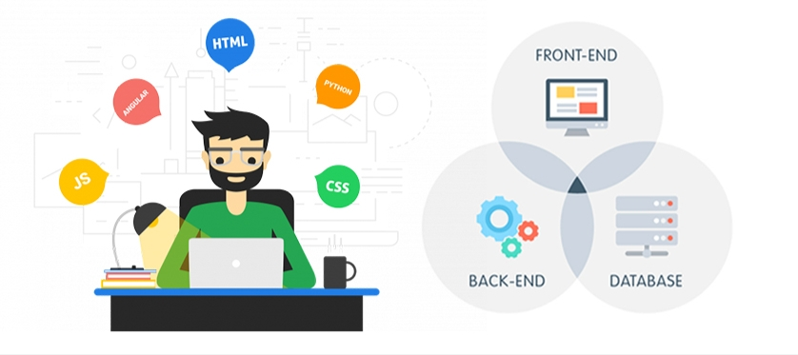
Full Stack Development
SETTI HEMANTH BABU
R170648 (CSE) Sec-D
Under guidance of
Mr. Ravi Kumar
Assistant Professor, IIIT RK Valley, RGUKT-AP

Slide 2
Introduction
Full stack development
It refers to the development of both front end(client side) and back end(server side) portions of web application.
Full Stack Web Developer
A full stack web developer is a person who can develop both client and server software.
In addition to mastering HTML and CSS, he/she also knows how to:
Program a browser (like using JavaScript, jQuery, Angular, or Vue)
Program a server (like using PHP, ASP, Python, or Node)
Program a database (like using SQL, SQLite, or MongoDB)
LAMP Stack: Linux, Apache, MySQL and PHP.

Slide 3
Languages
Client Software Server Software
(Front End) (Back End)
HTML PHP
CSS MySql
Bootstrap
JavaScript
ES6

Slide 4
Languages Introduction
Front end Languages: The front end portion is built by using some languages which are discussed below:
HTML: HTML stands for Hyper Text Markup Language. It is used to design the front end portion of web pages using markup language. HTML is the combination of Hypertext and Markup language. Hypertext defines the link between the web pages. The markup language is used to define the text documentation within tag which defines the structure of web pages.
CSS: Cascading Style Sheets, fondly referred to as CSS, is a simply designed language intended to simplify the process of making web pages presentable. CSS allows you to apply styles to web pages. More importantly, CSS enables you to do this independent of the HTML that makes up each web page.
JavaScript: JavaScript is a famous scripting language used to create the magic on the sites to make the site interactive for the user. It is used to enhancing the functionality of a website to running cool games and web-based software.
Front End Frameworks and Libraries:
Bootstrap: Bootstrap is a free and open-source tool collection for creating responsive websites and web applications. It is the most popular HTML, CSS, and JavaScript framework for developing responsive, mobile-first web sites

Slide 5
Languages Introduction
Back end: It refers to the server-side development of web application or website with a primary focus on how the website works. It is responsible for managing the database through queries and APIs by client-side commands. This type of website mainly consists of three parts front end, back end, and database.
PHP: PHP is a server-side scripting language designed specifically for web development. Since, PHP code executed on server side so it is called server side scripting language.
Database: Database is the collection of inter-related data which helps in efficient retrieval, insertion and deletion of data from database and organizes the data in the form of tables, views, schemas, reports etc.
Sql: Structured Query Language is a standard Database language which is used to create, maintain and retrieve the relational database.

Slide 6
Advantages Disadvantages
Advantages
The advantage of being a full stack web developer is:
You can master all the techniques involved in a development project
You can make a prototype very rapidly
You can provide help to all the team members
You can reduce the cost of the project
You can reduce the time used for team communication
You can switch between front and back end development based on requirements
You can better understand all aspects of new and upcoming technologies
Disadvantages
The solution chosen can be wrong for the project
The solution chosen can be dependent on developer skills
The solution can generate a key person risk
Being a full stack developer is increasingly complex

Slide 7
Website Introduction
In this technical era information plays vital role in any once life. Likewise for a University sharing of the features, placements, faculty, student’s achievements, location etc. are important and this can be achieved easily by maintaining a website because it will be available throughout the globe and updating of the website lets include the new features and new data so that everyone can see the same.
This website is user friendly and responsive that is whatever the size the viewing experience makes to comfortable to look in to it. Basically websites gives best experience in the laptops, desktops but making the site as responsive the same thing can be achieved through the small size screens like tablets, mainly phones.
This website enhances the popularity of the college within less time as it is available over the internet because many of them now a day’s most of the people first prefer to check details and visit later on.
The system allows admin to updates the events quickly in online notice board and those are reflected on user side so user can get updates .In this website the admin no need to worry on data by single click admin can update events and more. It uses PHP and MySQL database. It has two modules i.e.
Admin:
Admin is the super user of the website who can manage everything on the website. Admin can log in through the login page and can manage whole website for example he can update events on login.
User:
User can visit the application through a URL.
Purpose
The website describes over all facilities, features and other details. All those details are available in this campus website to enhances productivity in future

Slide 8
System Study
This chapter deals with the analysis of the system proposed by our guide. It covers the features, advantages and disadvantages of both the system.
Advantages
Focus more in administration instead of advertisement
High computing computers are not required
Available to users, all the time
Responsiveness of website makes users to in multiple sizes
Eco-friendly to admin
Admin can update the events easily
Available for multiple screen sizes
Available for mobile phones also
Disadvantages
Not flexible in flip and foldable phones
Data may not be perfect human error
Data may not be correct if it’s not updated
Security issues may raise if not get updated

Slide 9
System Study
Economical feasibility
Economic analysis is the most frequently used method for evaluating the effectiveness of a new system. More commonly known as cost/benefit analysis, the procedure is to determine the benefits and savings that are expected from a candidate system and compare them with costs. If benefits outweigh costs, then the decision is made to design and implement the system.
Technical feasibility
The technical feasibility in the proposed system deals with the technology used in the system. It deals with the hardware and software used in the system whether they are of latest technology or not. It happens that after a system is prepared a new technology arises and the user wants the system based on that technology. Thus it is important to check the system to be technically feasible.
Operational feasibility
The project has been developed in such a way that it becomes very easy even for a layman with little computer knowledge to operate it. The software is very user friendly and does not require any technical person to operate Thus the project is even operationally feasible.

Slide 10
Hardware Specification
User side:
Not required any hardware.
Required only internet access and computer.
Server side:
Ram
4GB
Hard disk
1TB
Processor
2.4GHz
Operating System
Server side OS like Unix

Slide 11
Software Requirement
Front End
HTML,CSS ,jquery,java script
Server side Language
PHP
Database Server
MySql
Web Browser
Firefox , Google Chrome or any compatible browser
Operating System
Ubuntu,Windows or any equivalent OS
Software
xampp

Slide 12
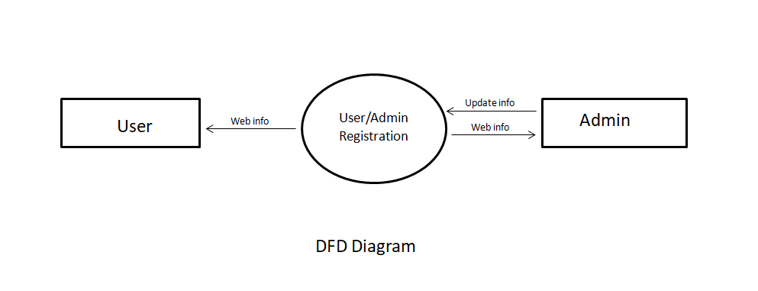
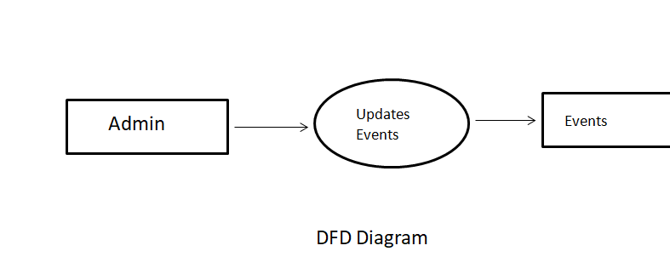
System Design
The system design is needed for information processing technology and the user interface development analysis. It contain a high level overview of the organization in which the common activities, processes and products are described in relation to how they create, use and modify information.
Below given dfd’s can be used to describe the overall user interface

Slide 13
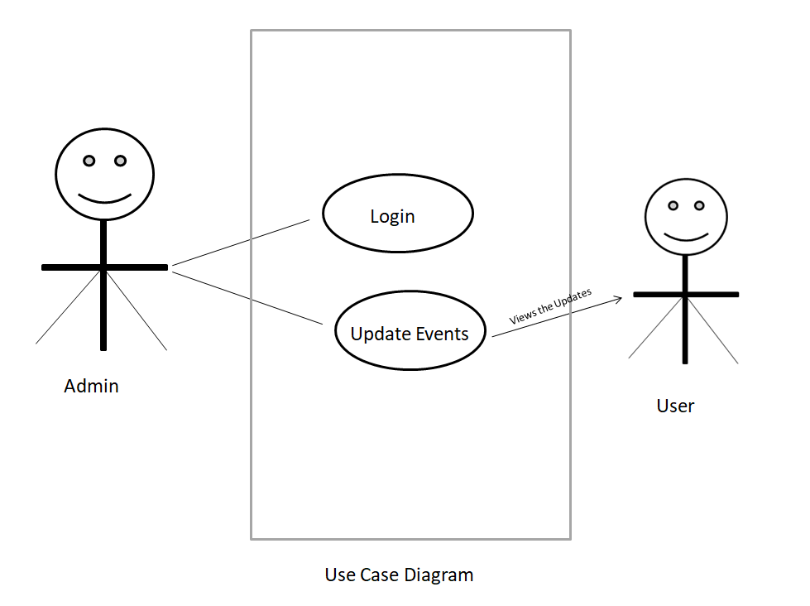
System Design
UML stands for Unified Modeling Language. UML is a language for specifying, visualizing and documenting the system. This is the step while developing any product after analysis. The goal from this is to produce a model of the entities involved in the project which later need to be built. The representation of the entities that are to be used in the product being developed need to be designed.

Slide 14
System Testing System testing is normally carried out in a planned manner according to the system test plan document. The system test plan identifies all testing-related activities that must be performed, specifies the schedule of testing, and allocates resources. It also lists all the test cases and the expected outputs for each test case. Here the modules are integrated in a planned manner.
Functional Testing
Functional testing refers to tests that verify a specific action or function of the code. These are usually found in the code requirements documentation, although some development methodologies work from use cases or user stories. Functional tests tend to answer the question of "can the user do this" or "does this particular feature work". Some examples of functional testing done in our project: By checking all the login modules, it is ensured that only registered users can access all the facilities.
Structural Testing
Structural testing is also called White box testing. This means a testing technique whereby explicit knowledge of the internal workings of the item being tested is used to select the test data. White box testing uses specific knowledge of programming code to examine outputs. The test is accurate only if the tester knows what the program is supposed to do. He or she can then see if the program diverges from its intended goal. White box testing does not account for errors caused by omission, and all visible code must also be readable.
System Testing
System testing of software or hardware is testing conducted on a complete, integrated system to evaluate the system's compliance with its specified requirements. System testing falls within the scope of black box testing, and as such, should require no knowledge of the inner design of the code or logic.
As a rule, system testing takes, as its input, all of the "integrated “software components that have successfully passed integration testing and also the software system itself integrated with any applicable hardware system(s). The purpose of integration testing is to detect any inconsistencies between the software units that are integrated together (called assemblages) or between any of the assemblages and the hardware. System testing is amore limiting type of testing; it seeks to detect defects both within the "inter-assemblages" and also within the system as a whole.
System testing is performed on the entire system in the context of a Functional Requirement Specification(s) (FRS) and/or a System Requirement Specification (SRS).System testing is an investigatory testing phase, where the focus is to have almost a destructive attitude and tests not only the design, but also the behaviour and even the believed expectations of the customer. It is also intended to test up to and beyond the bounds defined in the software/hardware requirements specification(s).

Slide 15
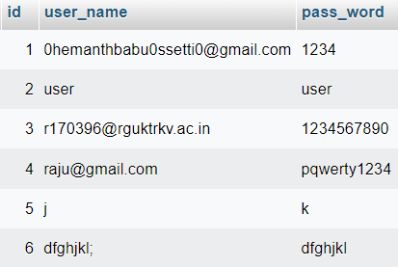
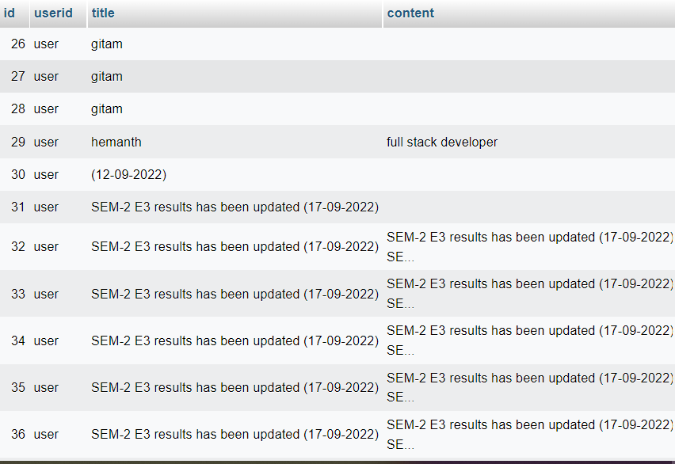
Database Schema
The goal of database design is to ensure that the data is represented in such a way that there is no redundancy and no extraneous data is generated, thus generate relationship in as high an order as possible. Having identified all the data on the system it is necessary to at the logical database design. Database design involves designing the conceptual model of the database. This model is independent of the physical representation of the data. Once the conceptual model is designed, it can be mapped to the DBMS/RDBMS that is actually being used.

Slide 16
Conclusion
The software is designed in such a way that future modifications can be done easily. The following conclusions can be deduced from the development of the project:
Automation of the tire system improves the efficiency. .
This application will avoid the manual work.
Updating of information becomes so easier.
It gives appropriate access to the authorized users depending on their permissions.
It records all events entered by the admin, these data can be processed for productivity. These data is used for display the on notice board for users. So the admin and authority persons don’t worry about the loss of data. Easily updates the data no need to update data on multiple places, once the data is entered then in respected areas it automatically updates the data.

Slide 17


